Slide 1
CHAPTER THREE
GRAPH

Slide 2
Graph Traversal
There are two fundamental graph traversal algorithms: depth-first search and breadth-first search.
Both algorithms are given a starting node in the graph, and they visit all nodes that can be reached from the starting node.
The difference in the algorithms is the order in which they visit the nodes.

Slide 3
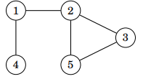
Depth-first search
Depth-first search (DFS) is a straightforward graph traversal technique. The algorithm begins at a starting node, and proceeds to all other nodes that are reachable from the starting node using the edges of the graph.
Depth-first search always follows a single path in the graph as long as it finds new nodes. After this, it returns to previous nodes and begins to explore other parts of the graph. The algorithm keeps track of visited nodes, so that it processes each node only once.
Example Let us consider how depth-first search processes the following graph:

Slide 4
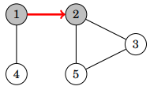
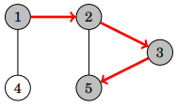
We may begin the search at any node of the graph; now we will begin the search at node 1.
The search first proceeds to node 2:
After this, nodes 3 and 5 will be visited:

Slide 5
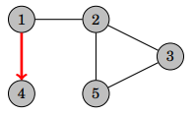
The neighbors of node 5 are 2 and 3, but the search has already visited both of them, so it is time to return to the previous nodes. Also the neighbors of nodes 3 and 2 have been visited, so we next move from node 1 to node 4:
After this, the search terminates because it has visited all nodes.
The time complexity of depth-first search is O(n + m) where n is the number of nodes and m is the number of edges, because the algorithm processes each node and edge once

Slide 6
Recursive implementation
using stack implementation
vector<int> adj[N];
bool visited[N];
void dfs(int s){ stack<int> nodes;
nodes.push(s); visited[s]=true;
while(!s.empty){
int d = nodes.top();nodes.pop();
cout<<d<<“ “;
for(auto u: adj[d])
if(!visited[u]) {
nodes.push(u);
visited[u] = true;
}
}
}
vector<int> adj[N];
bool visited[N]; void dfs(int s) { if (visited[s]) return; visited[s] = true;
cout<<s<<“ ”; for (auto u: adj[s]) { dfs(u); } }

Slide 7
Breadth-first search
Breadth-first search (BFS) visits the nodes in increasing order of their distance from the starting node. Thus, we can calculate the distance from the starting node to all other nodes using breadth-first search. However, breadth-first search is more difficult to implement than depth-first search.
Breadth-first search goes through the nodes one level after another. First the search explores the nodes whose distance from the starting node is 1, then the nodes whose distance is 2, and so on. This process continues until all nodes have been visited.

Slide 8
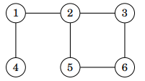
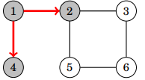
Example:
Let us consider how breadth-first search processes the following graph:
Suppose that the search begins at node 1. First, we process all nodes that can be reached from node 1 using a single edge:

Slide 9
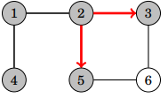
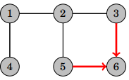
After this, we proceed to nodes 3 and 5:
Finally, we visit node 6:
Like in depth-first search, the time complexity of breadth-first search is O(n + m), where n is the number of nodes and m is the number of edges.

Slide 10
using queue implementation
vector<int> adj[N];
bool visited[N];
void bfs(int s){ queue<int> nodes;
nodes.push(s); visited[s]=true;
while(!s.empty){
int d = nodes.top();nodes.pop();
cout<<d<<“ “;
for(auto u: adj[d])
if(!visited[u]) {
nodes.push(u);
visited[u] = true;
}
}
}

Slide 11
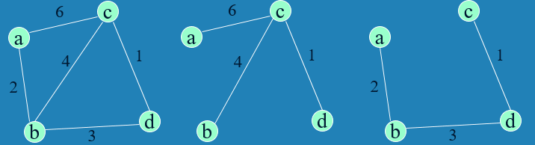
Minimum Spanning Tree (MST)
Spanning tree of a connected graph G: a connected acyclic subgraph of G that includes all of G’s vertices
Minimum spanning tree of a weighted, connected graph G: a spanning tree of G of the minimum total weight
Example:

Slide 12
Prim’s MST algorithm
Start with tree T₁ consisting of one (any) vertex and “grow” tree one vertex at a time to produce MST through a series of expanding subtrees T₁, T₂, …, T_{n.}
On each iteration, construct T_{i+1} from T_{i} by adding vertex not in T_{i} that is closest to those already in T_{i} (this is a “greedy” step!)
Stop when all vertices are included

Slide 13
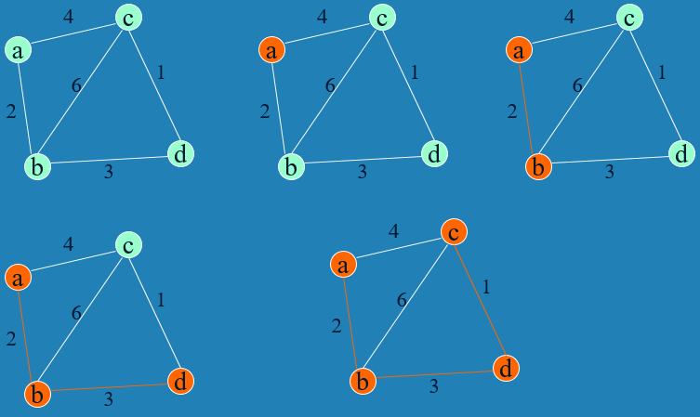

Slide 14
Efficiency
O(n²) for weight matrix representation of graph and array implementation of priority queue O(m log n) for adjacency lists representation of graph with n vertices and m edges and min-heap implementation of the priority queue.

Slide 15
vector< pair<int, ii> > EdgeList;
for (int i = 0; i < E; i++) {
scanf("%d %d %d", &u, &v, &w);
EdgeList.push_back(make_pair(w, ii(u, v)));
}
sort(EdgeList.begin(), EdgeList.end());
int mst_cost = 0;
UnionFind UF(V);
for (int i = 0; i < E; i++) {
pair<int, ii> front = EdgeList[i];
if (!UF.isSameSet(front.second.first,front.second.second)) {
mst_cost += front.first;
UF.unionSet(front.second.first, front.second.second);
}
}
printf("MST cost = %d (Kruskal’s)\n", mst_cost);

Slide 16
Kruskal’s
Sort the edges in non decreasing order of lengths
“Grow” tree one edge at a time to produce MST through a series of expanding forests F₁, F₂, …, F_{n-1}
On each iteration, add the next edge on the sorted list unless this would create a cycle. (If it would, skip the edge.)

Slide 17
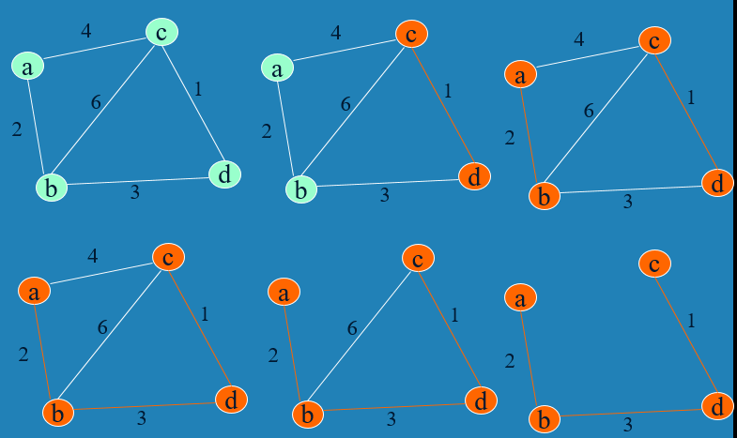

Slide 18
Algorithm looks easier than Prim’s but is harder to implement (checking for cycles!)
Cycle checking: a cycle is created if added edge connects vertices in the same connected component
Union-find algorithms
Runs in O(m log m) time, with m = |E|. The time is mostly spent on sorting.

